Slide 1
Proyek Akhir TSA Network Programmability
Elyaser Ben Guno - 1806195135 - Universitas Indonesia
Kelas C - TSA Network Programmability

Slide 2
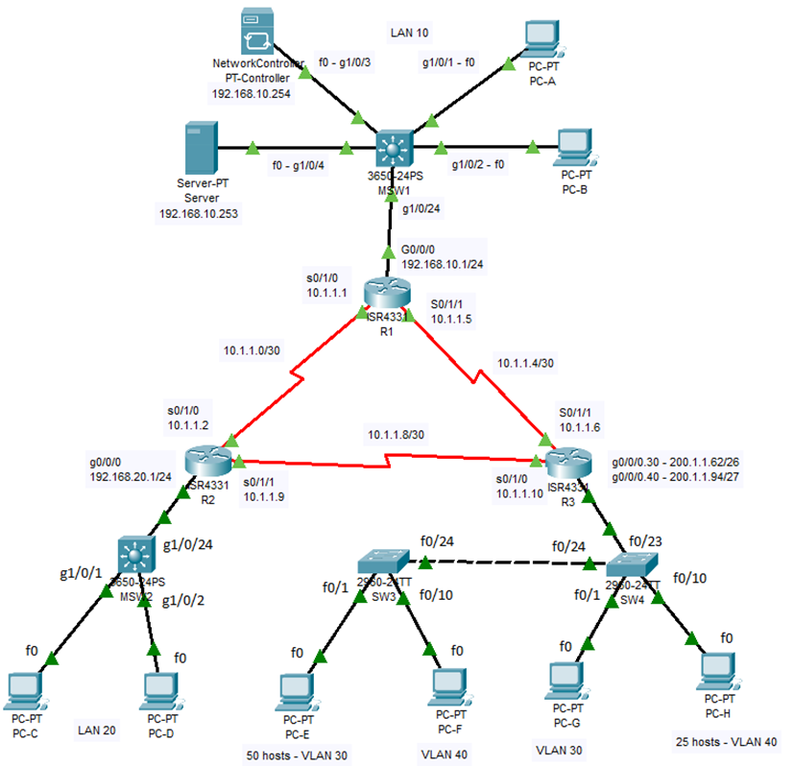
1
Mendesain dan Membangun Jaringan Kecil

Slide 3
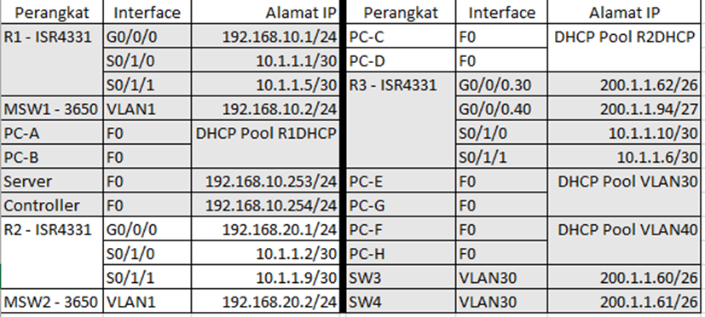
Skema pengalamatan

Slide 4
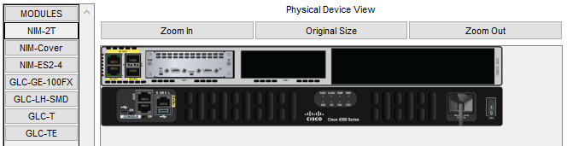
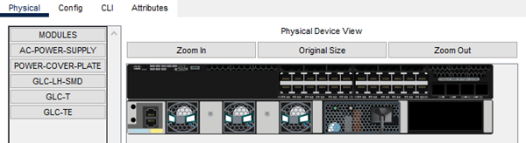
Konfigurasi fisik perangkat router ISR4331 dan multilayer switch 3650
Router: ISR4331 dengan tambahan modul NIM-2T
Multilayer switch 3650 dipasangi modul power supply

Slide 5
Konfigurasi pada area LAN 10
Server, R1, MSW1, PC-A, PC-B

Slide 6
Konfigurasi server
IPv4 address: 192.168.10.253 Default gateway: 192.168.10.1
Subnet mask: 255.255.255.0 DNS Server: 192.168.10.253
Nama | Tipe Record | Alamat IP
yaserbelajar.com | A | 192.168.10.253
controller.yaserbelajar.com | A | 192.168.10.254

Slide 7
Konfigurasi R1
2 - Konfig interface
1 - Konfig dasar
R1(config)#int g0/0/0
R1(config-if)#description R1 LAN
R1(config-if)#ip address 192.168.10.1 255.255.255.0
R1(config-if)#no shutdown
R1(config-if)#int s0/1/0
R1(config-if)#description Link to R2
R1(config-if)#ip address 10.1.1.1 255.255.255.252
R1(config-if)#no shutdown
R1(config-if)#int s0/1/1
R1(config-if)#description Link to R3
R1(config-if)#ip address 10.1.1.5 255.255.255.252
R1(config-if)#no shutdown
R1(config-if)#exit
R1(config)#
R1(config)#router ospf 10
R1(config-router)#router-id 1.1.1.1
R1(config-router)#network 192.168.10.0 0.0.0.255 area 0
R1(config-router)#network 10.1.1.0 0.0.0.3 area 0
R1(config-router)#network 10.1.1.4 0.0.0.3 area 0
R1(config-router)#passive-interface g0/0/0
R1(config-router)#exit
R1(config)#
4 - Konfig DHCP
Router>en
Router#conf t
Router(config)#hostname R1
R1(config)#enable secret Pr1vil3ge!
R1(config)#line console 0
R1(config-line)#password CoNs0le!
R1(config-line)#exit
R1(config)#service password-encryption
R1(config)#ip domain-name yaserbelajar.com
R1(config)#crypto key generate rsa
How many bits in the modulus [512]: 1024
R1(config)#username yaser password P@ssw0rd!
R1(config)#line vty 0 4
R1(config-line)#login local
R1(config-line)#transport input ssh
R1(config-line)#exit
R1(config)#
R1(config)#ip dhcp pool R1DHCP
R1(dhcp-config)#network 192.168.10.0 255.255.255.0
R1(dhcp-config)#default-router 192.168.10.1
R1(dhcp-config)#dns-server 192.168.10.253
R1(dhcp-config)#exit
R1(config)#ip dhcp excluded-address 192.168.10.1
R1(config)#ip dhcp excluded-address 192.168.10.253 192.168.10.254
R1(config)#end
R1#copy run start
3 - Konfig OSPF

Slide 8
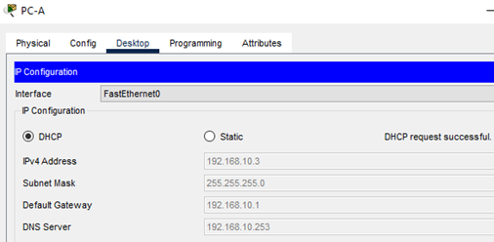

Konfigurasi MSW1
Verifikasi DHCP PC-A & B
Switch>en
Switch#conf t
Switch(config)#hostname MSW1
MSW1(config)#int vlan 1
MSW1(config-if)#ip address 192.168.10.2 255.255.255.0
MSW1(config-if)#no shutdown
MSW1(config-if)#exit
MSW1(config)#ip default-gateway 192.168.10.1
MSW1(config)#enable secret Pr1vil3ge!
MSW1(config)#line console 0
MSW1(config-line)#password CoNs0le!
MSW1(config-line)#exit
MSW1(config)#service password-encryption
MSW1(config)#ip domain-name yaserbelajar.com
MSW1(config)#crypto key generate rsa
How many bits in the modulus [512]: 1024
MSW1(config)#username yaser password P@ssw0rd!
MSW1(config)#line vty 0 4
MSW1(config-line)#login local
MSW1(config-line)#transport input ssh
MSW1(config-line)#end
MSW1#copy run start

Slide 9
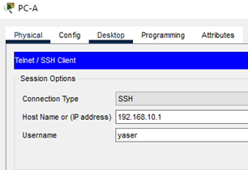
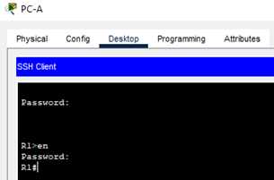
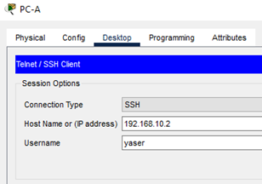

Verifikasi SSH ke R1 & MSW1
SSH ke R1 pakai PC-A
SSH ke MSW1 pakai PC-A

Slide 10
Konfigurasi pada area LAN 20
R2, MSW2, PC-C, PC-D

Slide 11
Konfigurasi R2
2 - Konfig interface
1 - Konfig dasar
R2(config)#int g0/0/0
R2(config-if)#description R2 LAN
R2(config-if)#ip address 192.168.20.1 255.255.255.0
R2(config-if)#no shutdown
R2(config-if)#int s0/1/0
R2(config-if)#description Link to R1
R2(config-if)#ip address 10.1.1.2 255.255.255.252
R2(config-if)#no shutdown
R2(config-if)#int s0/1/1
R2(config-if)#description Link to R3
R2(config-if)#ip address 10.1.1.9 255.255.255.252
R2(config-if)#no shutdown
R2(config-if)#exit
R2(config)#
R2(config)#router ospf 10
R2(config-router)#router-id 2.2.2.2
R2(config-router)#network 192.168.20.1 0.0.0.0 area 0
R2(config-router)#network 10.1.1.2 0.0.0.0 area 0
R2(config-router)#network 10.1.1.9 0.0.0.0 area 0
R2(config-router)#passive-interface g0/0/0
R2(config-router)#exit
R2(config)#
4 - Konfig DHCP
Router>en
Router#conf t
Router(config)#hostname R2
R2(config)#enable secret Pr1vil3ge!
R2(config)#line console 0
R2(config-line)#password CoNs0le!
R2(config-line)#exit
R2(config)#service password-encryption
R2(config)#ip domain-name yaserbelajar.com
R2(config)#crypto key generate rsa
How many bits in the modulus [512]: 1024
R2(config)#username yaser password P@ssw0rd!
R2(config)#line vty 0 4
R2(config-line)#login local
R2(config-line)#transport input ssh
R2(config-line)#exit
R2(config)#
R2(config)#ip dhcp pool R2DHCP
R2(dhcp-config)#network 192.168.20.0 255.255.255.0
R2(dhcp-config)#default-router 192.168.20.1
R2(dhcp-config)#dns-server 192.168.10.253
R2(dhcp-config)#exit
R2(config)#ip dhcp excluded-address 192.168.20.1
R2(config)#end
R2#copy run start
3 - Konfig OSPF

Slide 12


Konfigurasi MSW2
Verifikasi DHCP PC-C & D
Switch>en
Switch#conf t
Switch(config)#hostname MSW2
MSW2(config)#int vlan 1
MSW2(config-if)#ip address 192.168.20.2 255.255.255.0
MSW2(config-if)#no shutdown
MSW2(config-if)#exit
MSW2(config)#ip default-gateway 192.168.20.1
MSW2(config)#enable secret Pr1vil3ge!
MSW2(config)#line console 0
MSW2(config-line)#password CoNs0le!
MSW2(config-line)#exit
MSW2(config)#service password-encryption
MSW2(config)#ip domain-name yaserbelajar.com
MSW2(config)#crypto key generate rsa
How many bits in the modulus [512]: 1024
MSW2(config)#username yaser password P@ssw0rd!
MSW2(config)#line vty 0 4
MSW2(config-line)#login local
MSW2(config-line)#transport input ssh
MSW2(config-line)#end
MSW2#copy run start

Slide 13
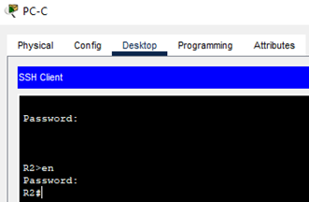
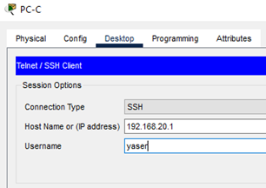


Verifikasi SSH ke R2 & MSW2
SSH ke R2 pakai PC-C
SSH ke MSW2 pakai PC-C

Slide 14
Konfigurasi pada area VLAN 30 & 40
R3, SW3, SW4, PC-E, PC-F, PC-G, PC-H

Slide 15
Konfigurasi SW3
1 - Konfig vlan & trunking
2 - Konfig dasar
Switch>en
Switch#conf t
Switch(config)#hostname SW3
SW3(config)#vlan 30
SW3(config-vlan)#name SALES
SW3(config-vlan)#exit
SW3(config)#vlan 40
SW3(config-vlan)#name ACCOUNTS
SW3(config-vlan)#exit
SW3(config)#
SW3(config)#int range f0/1 - 9
SW3(config-if-range)#switchport mode access
SW3(config-if-range)#switchport access vlan 30
SW3(config-if-range)#spanning-tree portfast
SW3(config-if-range)#exit
SW3(config)#interface range f0/10 - 20
SW3(config-if-range)#switchport mode access
SW3(config-if-range)#switchport access vlan 40
SW3(config-if-range)#exit
SW3(config)#interface f0/24
SW3(config-if)#switchport mode trunk
SW3(config-if)#exit
SW3(config)#enable secret Pr1vil3ge!
SW3(config)#line console 0
SW3(config-line)#password CoNs0le!
SW3(config-line)#exit
SW3(config)#service password-encryption
SW3(config)#int vlan 30
SW3(config-if)#ip address 200.1.1.60 255.255.255.192
SW3(config-if)#no shutdown
SW3(config-if)#exit
SW3(config)#ip default-gateway 200.1.1.62
SW3(config)#ip domain-name yaserbelajar.com
SW3(config)#crypto key generate rsa
How many bits in the modulus [512]: 1024
SW3(config)#username yaser password P@ssw0rd!
SW3(config)#line vty 0 4
SW3(config-line)#login local
SW3(config-line)#transport input ssh
SW3(config)#exit
SW3#copy run start

Slide 16
Konfigurasi SW4
1 - Konfig vlan & trunking
2 - Konfig dasar
Switch>en
Switch#conf t
Switch(config)#hostname SW4
SW4(config)#vlan 30
SW4(config-vlan)#name SALES
SW4(config-vlan)#exit
SW4(config)#vlan 40
SW4(config-vlan)#name ACCOUNTS
SW4(config-vlan)#exit
SW4(config)#interface f0/24
SW4(config-if)#switchport mode trunk
SW4(config-if)#exit
SW4(config)#interface f0/23
SW4(config-if)#switchport mode trunk
SW4(config-if)#exit
SW4(config)#interface range f0/1 - 9
SW4(config-if-range)#switchport mode access
SW4(config-if-range)#switchport access vlan 30
SW4(config-if-range)#exit
SW4(config)#interface range f0/10 - 20
SW4(config-if-range)#switchport mode access
SW4(config-if-range)#switchport access vlan 40
SW4(config-if-range)#exit
SW4(config)#enable secret Pr1vil3ge!
SW4(config)#line console 0
SW4(config-line)#password CoNs0le!
SW4(config-line)#exit
SW4(config)#service password-encryption
SW4(config)#int vlan 30
SW4(config-if)#ip address 200.1.1.61 255.255.255.192
SW4(config-if)#no shutdown
SW4(config-if)#exit
SW4(config)#ip default-gateway 200.1.1.62
SW4(config)#ip domain-name yaserbelajar.com
SW4(config)#crypto key generate rsa
How many bits in the modulus [512]: 1024
SW4(config)#username yaser password P@ssw0rd!
SW4(config)#line vty 0 4
SW4(config-line)#login local
SW4(config-line)#transport input ssh
SW4(config-line)#exit
SW4(config)#end
SW4#copy run start

Slide 17
Konfigurasi R3
2 - Konfig DHCP
R3(config)#ip dhcp pool VLAN30
R3(dhcp-config)#network 200.1.1.0 255.255.255.192
R3(dhcp-config)#default-router 200.1.1.62
R3(dhcp-config)#dns-server 192.168.10.253
R3(dhcp-config)#exit
R3(config)#
R3(config)#ip dhcp pool VLAN40
R3(dhcp-config)#network 200.1.1.64 255.255.255.224
R3(dhcp-config)#default-router 200.1.1.94
R3(dhcp-config)#dns-server 192.168.10.253
R3(dhcp-config)#exit
R3(config)#ip dhcp excluded-address 200.1.1.1 200.1.1.5
R3(config)#ip dhcp excluded-address 200.1.1.65 200.1.1.70
R3(config)#router ospf 10
R3(config-router)#router-id 3.3.3.3
R3(config-router)#exit
R3(config)#interface g0/0/0.30
R3(config-subif)#ip ospf 10 area 0
R3(config-subif)#int g0/0/0.40
R3(config-subif)#ip ospf 10 area 0
R3(config-subif)#int s0/1/0
R3(config-if)#ip ospf 10 area 0
R3(config-if)#int s0/1/1
R3(config-if)#ip ospf 10 area 0
R3(config-if)#exit
R3(config)#router ospf 10
R3(config-router)#passive-interface g0/0/0
R3(config-router)#exit
1 - Konfig interface & subinterface
Router>en
Router#conf t
Enter configuration commands, one per line. End with CNTL/Z.
Router(config)#hostname R3
R3(config)#int g0/0/0
R3(config-if)#no ip address
R3(config-if)#no shutdown
R3(config-if)#int g0/0/0.30
R3(config-subif)#encapsulation dot1Q 30
R3(config-subif)#ip address 200.1.1.62 255.255.255.192
R3(config-subif)#exit
R3(config)#int g0/0/0.40
R3(config-subif)#encapsulation dot1Q 40
R3(config-subif)#ip address 200.1.1.94 255.255.255.224
R3(config-subif)#exit
R3(config)#int s0/1/0
R3(config-if)#description Link to R2
R3(config-if)#ip address 10.1.1.10 255.255.255.252
R3(config-if)#no shutdown
R3(config-if)#int s0/1/1
R3(config-if)#description Link to R1
R3(config-if)#ip address 10.1.1.6 255.255.255.252
R3(config-if)#no shutdown
R3(config-if)#exit
4 - Konfig dasar
R3(config)#enable secret Pr1vil3ge!
R3(config)#line console 0
R3(config-line)#password CoNs0le!
R3(config-line)#exit
R3(config)#service password-encryption
R3(config)#ip domain-name yaserbelajar.com
R3(config)#crypto key generate rsa
How many bits in the modulus [512]: 1024
R3(config)#username yaser password P@ssw0rd!
R3(config)#line vty 0 4
R3(config-line)#login local
R3(config-line)#transport input ssh
R3(config-line)#exit
R3(config)#end
R3#copy run start
3 - Konfig OSPF

Slide 18
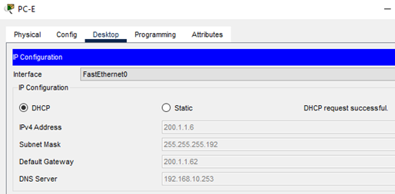



Verifikasi DHCP PC-E, F, G, dan H

Slide 19
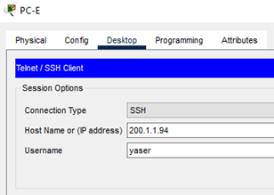




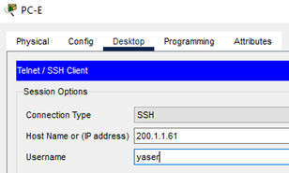
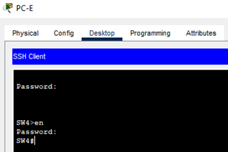
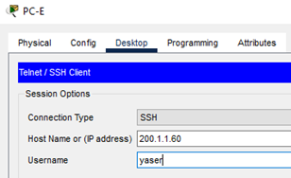
Verifikasi SSH ke R3, SW3, dan SW4 pakai PC-E
R3 via GW VLAN 30 R3 via GW VLAN 40
SW3 SW4

Slide 20
Verifikasi konektivitas dan OSPF

Slide 21
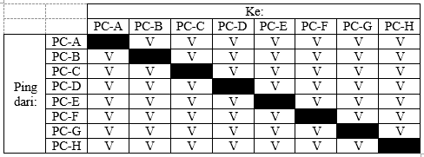
Verifikasi konektivitas

Slide 22
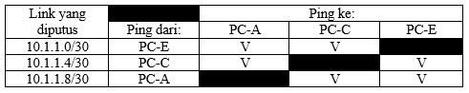
Verifikasi OSPF

Slide 23
2
Manajemen Jaringan dengan SDN Controller
Konfigurasi global SDN controller:
Gateway = 192.168.10.1
Server DNS = 192.168.10.253
NTP = 192.168.10.253
Alamat IP SDN = 192.168.10.254
HTTP port = 58001
Akun pengelola:
Username = “yaser”
Password = “P@ssw0rd!”
Diakses dengan:
Browser = controller.yaserbelajar.com

Slide 24
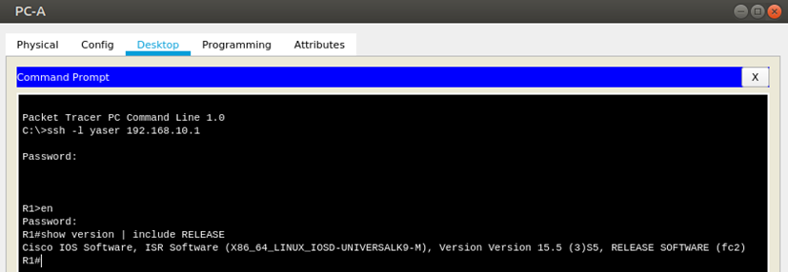
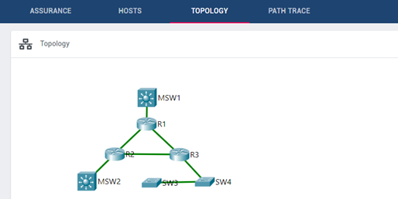
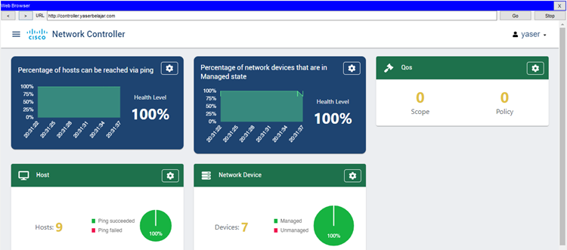
Membandingkan pengumpulan informasi dengan CLI vs SDN controller
CLI:
SSH satu-satu ke perangkat
Lalu masukkan command
Gather
information w/CLI
SDN:
Secara otomatis mendapat informasi real-time
Tampilan lebih menarik
Discover topology
w/ SDN
Gather
information
w/ SDN

Slide 25
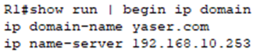
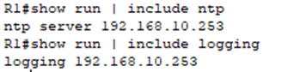
Konfigurasi perangkat jaringan dengan SDN
Mengubah pengaturan DNS dimana domain name menjadi “yaser.com” pada IP 192.168.10.253, lalu NTP dan SYSLOG menggunakan IP 192.168.10.253 juga. Setelah masing-masing pengaturan telah di-save, selanjutnya push config tersebut.
Dilakukan pengecekan config ip domain, NTP, dan SYSLOG pada R1. Hal ini berlaku untuk semua perangkat jaringan lainnya.

Slide 26
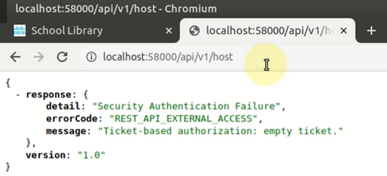
3
Implementasi REST API dengan SDN Controller
Verifikasi konektivitas eksternal ke packet tracer
Untuk verifikasi koneksi eksternal, pastikan pada option > preferences > miscellaneous, untuk Enable External Access for Network Controller REST API-nya telah dicentang. Lalu, buka “localhost:58000/api/v1/host” pada browser

Slide 27
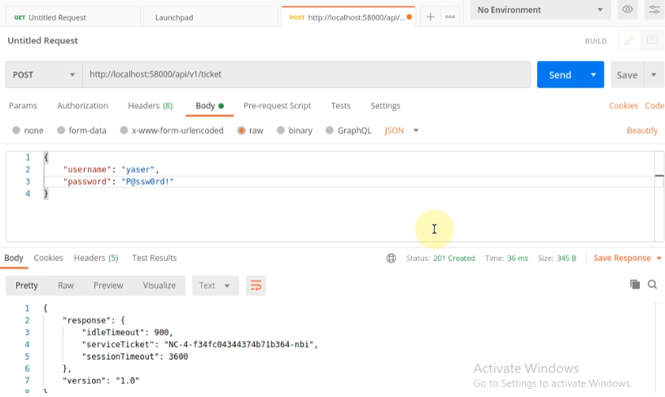
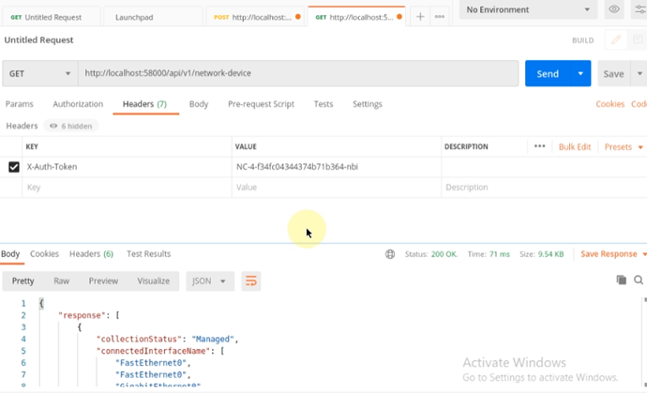
Request REST dengan Postman
Request token otentikasi dengan Postman Request REST dengan Postman

Slide 28
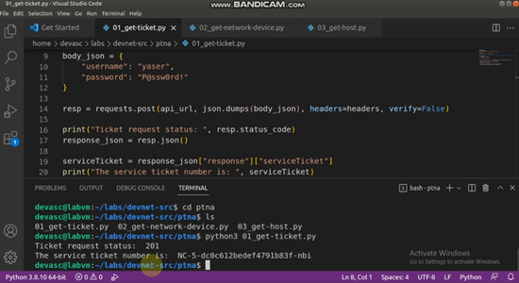
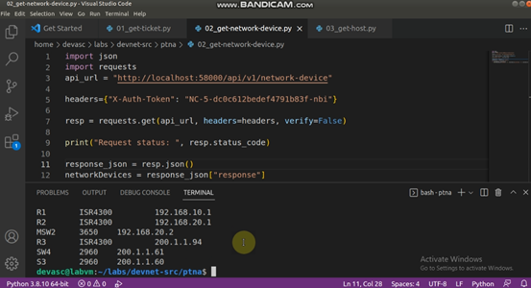
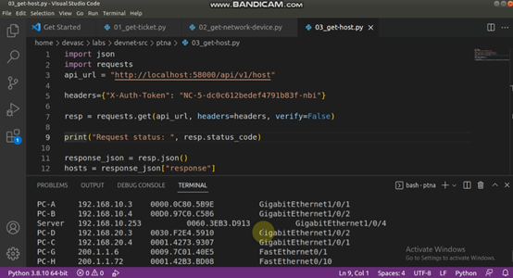
Request REST dengan VS Code
Menjalankan 3 script yang ada di direktori labs/devnet-src/ptna
Mendapatkan auth token
Mendapatkan info network device
Mendapatkan info host

Slide 29
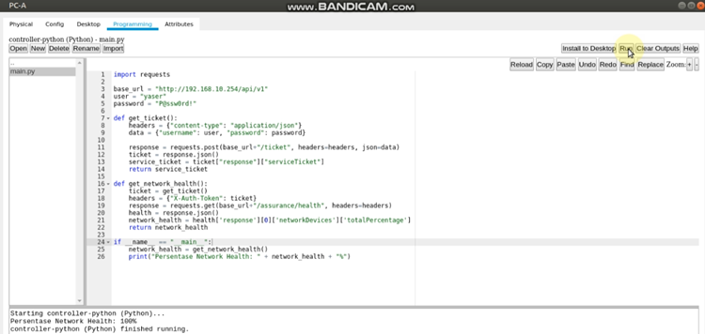
Integrasi dan mengirim request REST API dengan Python di Dalam Packet Tracer

Slide 30
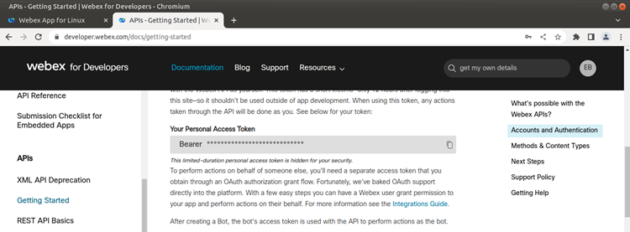
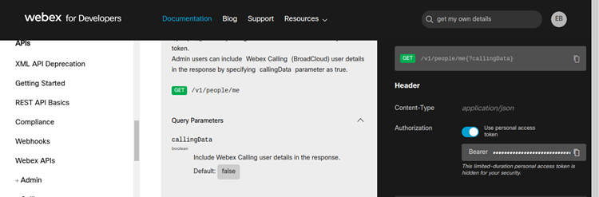
4
Membuat Python Script untuk Mengelola Webex Teams
Mendapatkan access token

Slide 31
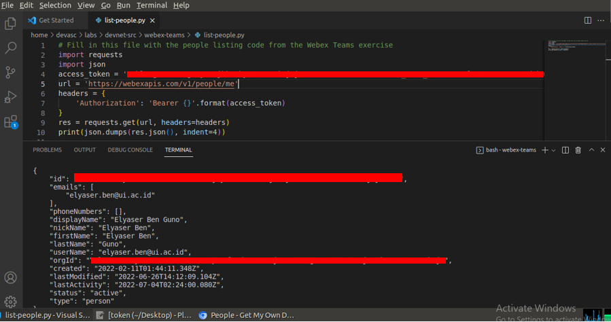
Manage people in webex teams
memverifikasi & mengelola akun tersebut dengan menjalankan script list-people.py

Slide 32
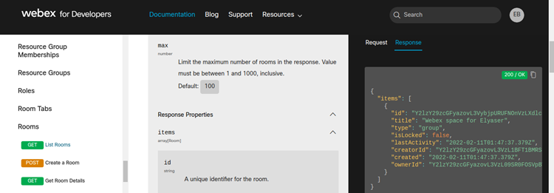
Manage rooms and messages in webex teams
cari tahu room id kita dengan mengunjungi tautan berikut ini https://developer.webex.com/docs/api/v1/rooms/list-rooms. Berikut room id-nya.

Slide 33
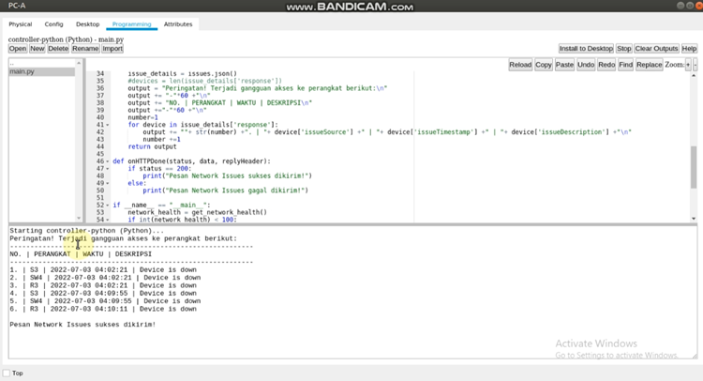
Manage rooms and messages in webex teams

Slide 34
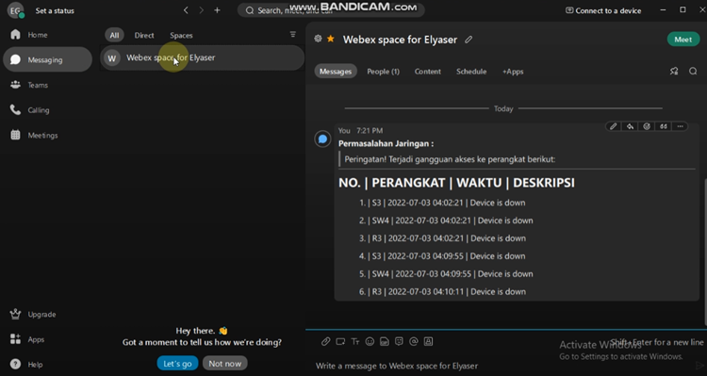
Manage rooms and messages in webex teams

Slide 35
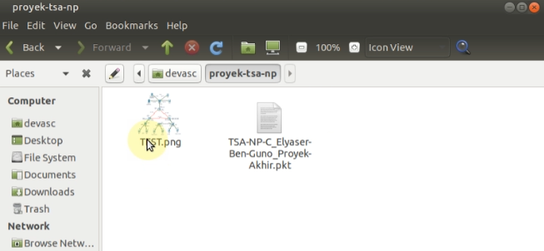
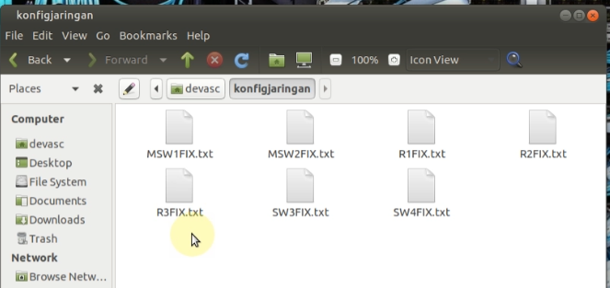
5
Software Version Control dengan Git
Membuat repositori proyek-tsa-np, lalu membuat file konfigJaringan.txt yang berisi gabungan 7 file txt konfigurasi. Terakhir, repositori akan diintegrasikan ke GitHub.

Slide 36
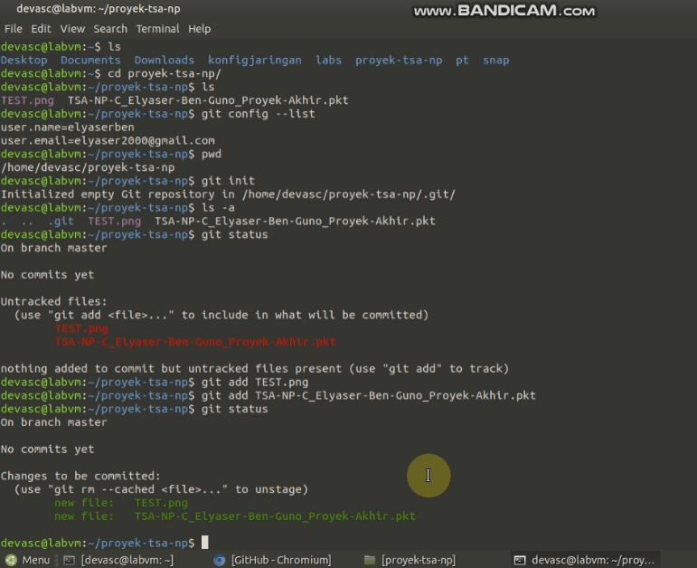
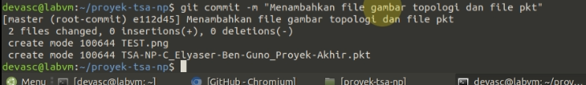
Inisialisasi, cek status, staging, dan commit.

Slide 37
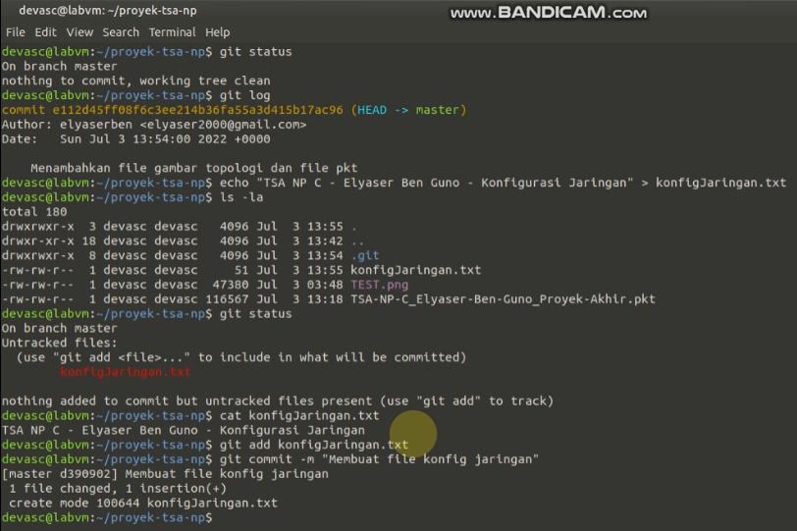
membuat, men-staging, dan meng-commit konfigJaringan.txt

Slide 38
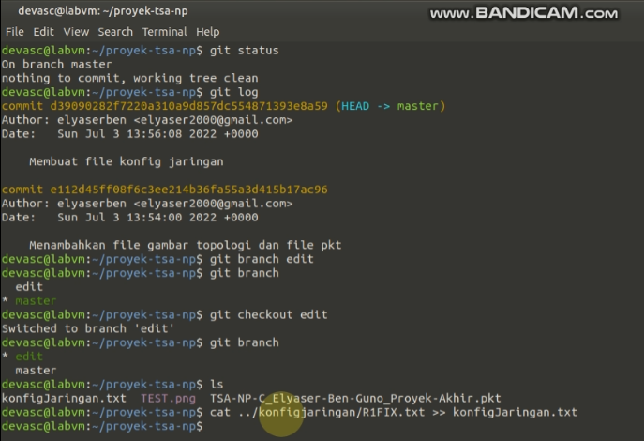
membuat branch edit, mengedit konfigJaringan.txt dimana ditambahkan konten dari 7 file konfig perangkat jaringan

Slide 39
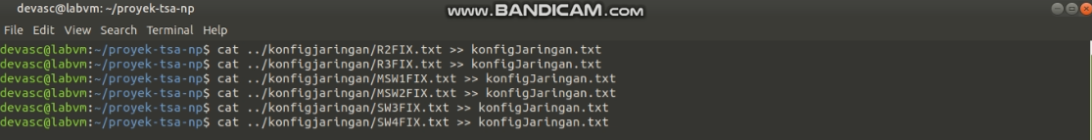
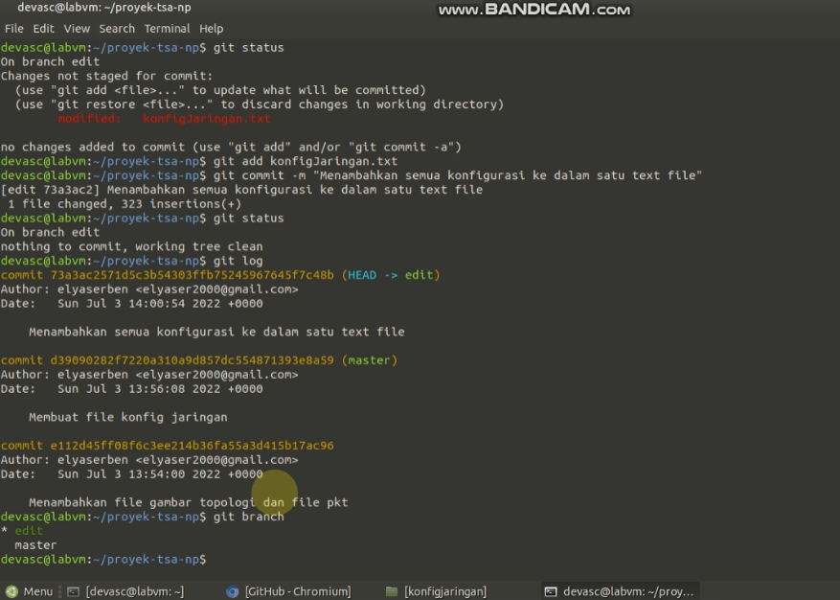
mengedit konfigJaringan.txt dimana ditambahkan konten dari 7 file konfig perangkat jaringan
men-staging dan meng-commit konfigJaringan.txt pada branch edit

Slide 40
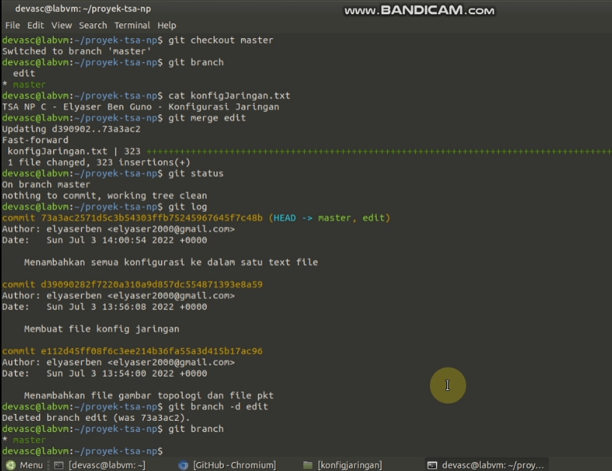
merge branch master dan branch edit, lalu menghapus branch edit.

Slide 41
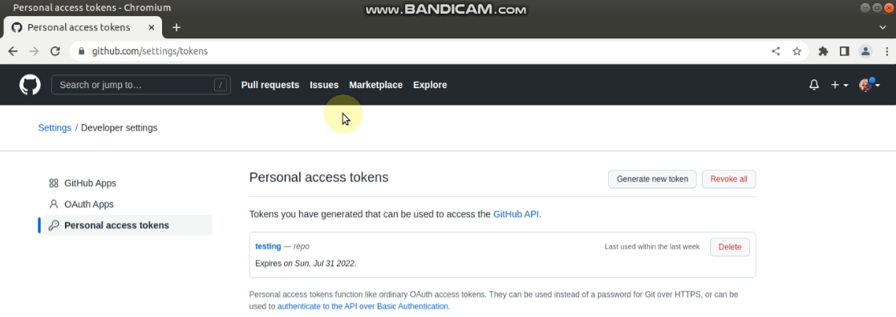
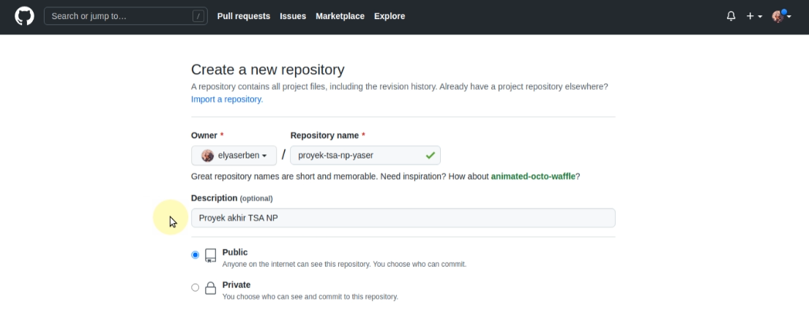
membuat personal access token
membuat repositori

Slide 42
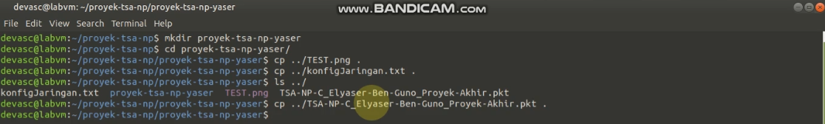
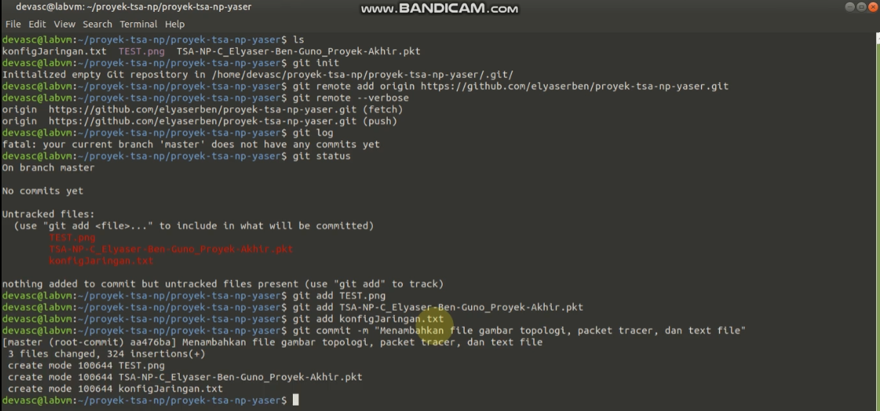
membuat & menginisialisasi repositori lokal baru
menyalin konten dari repo sebelumnya ke repo baru
mengintegrasikan repo lokal dengan repo github
men-staging dan meng-commit

Slide 43
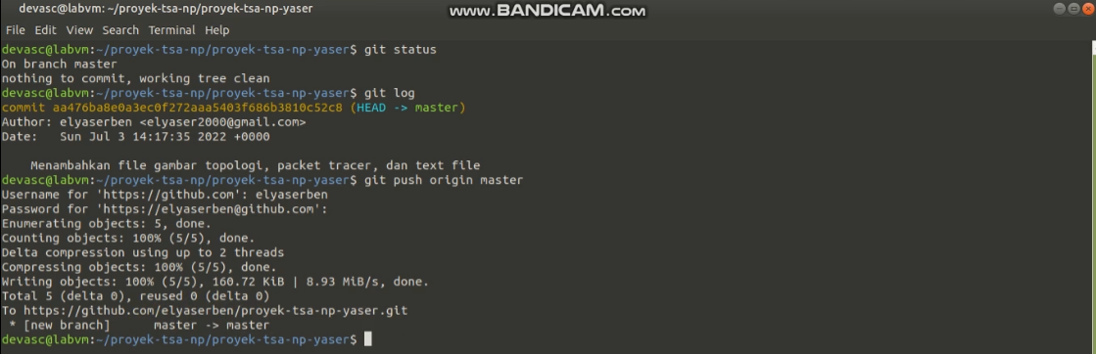
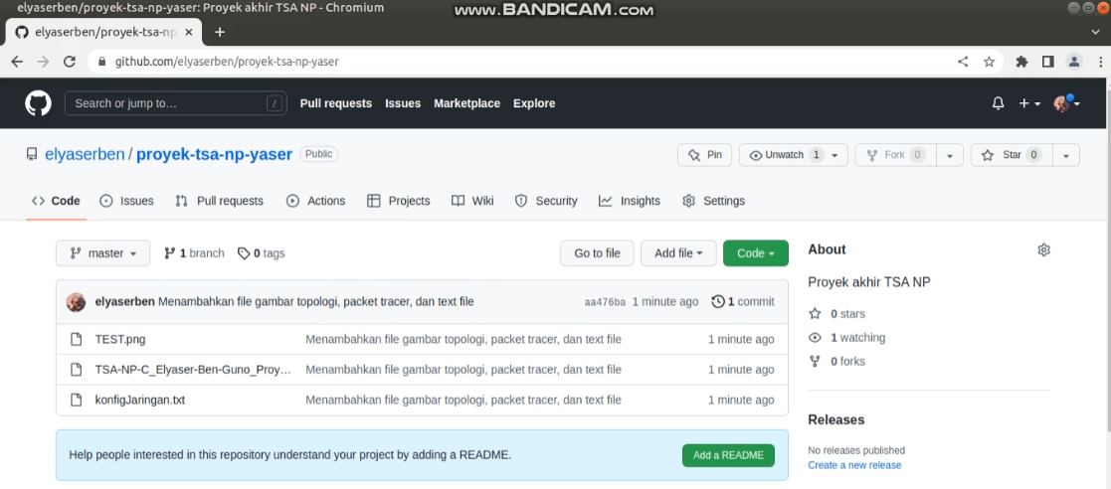
mengintegrasikan repo lokal dengan repo github
integrasi berhasil

Slide 44
Tautan:
PART 1: Mendesain dan Membangun Jaringan Kecil (30 menit):
https://youtu.be/IM265BN-Rk8
PART 2: Manajemen Jaringan dengan SDN Controller (10 menit):
https://youtu.be/SeURgGzrV4o
PART 3: Implementasi REST API dengan SDN Controller (10 menit):
https://youtu.be/sWyxBVKriCo
PART 4: Membuat Python Script untuk Mengelola Webex Teams (7 menit):
https://youtu.be/ZaMA-l2RZ5I
PART 5: Software Version Control dengan Git (14 menit):
https://youtu.be/OCwkS1bGLb0
Link Github proyek: https://github.com/elyaserben/proyek-tsa-np-yaser
Referensi Github Pak Putu: https://github.com/iputuhariyadi/sdn

Slide 45
sekian
terima
kasih

